Slide 1

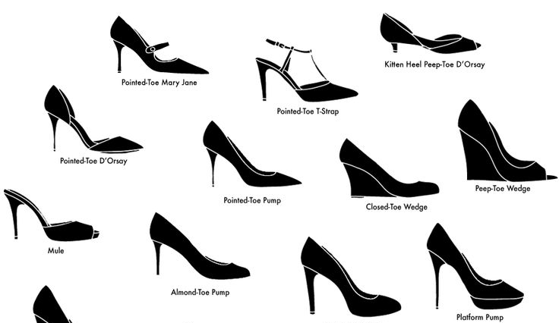
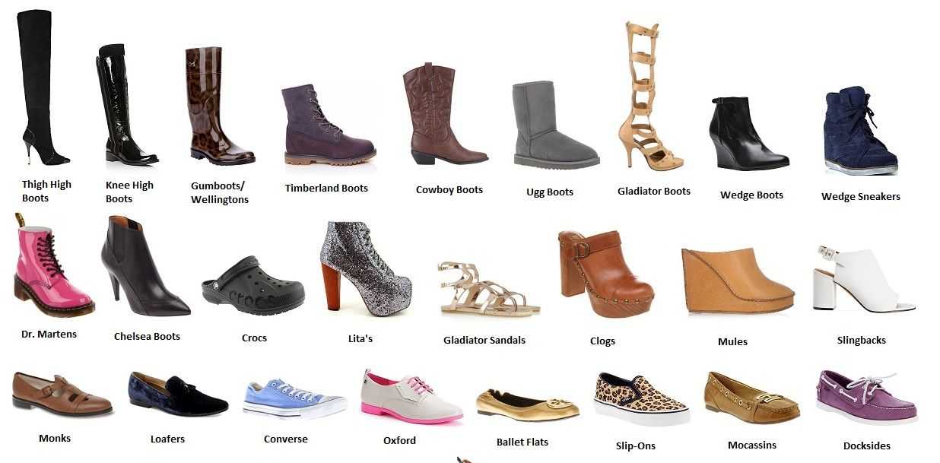
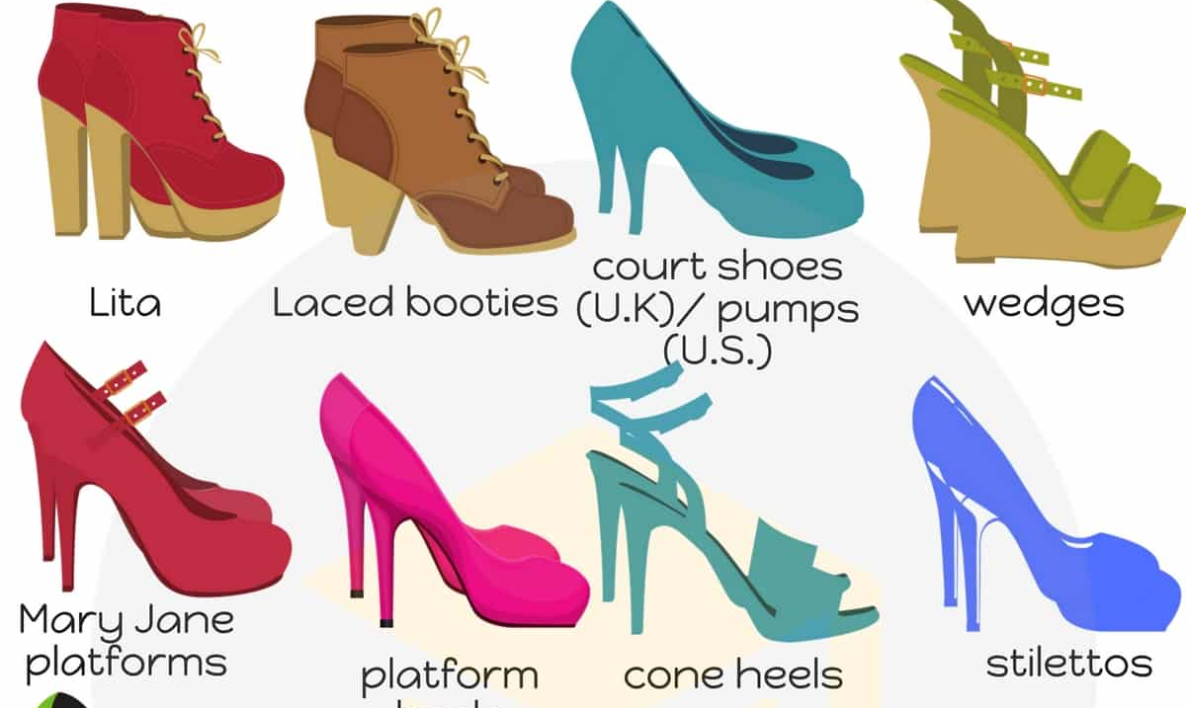
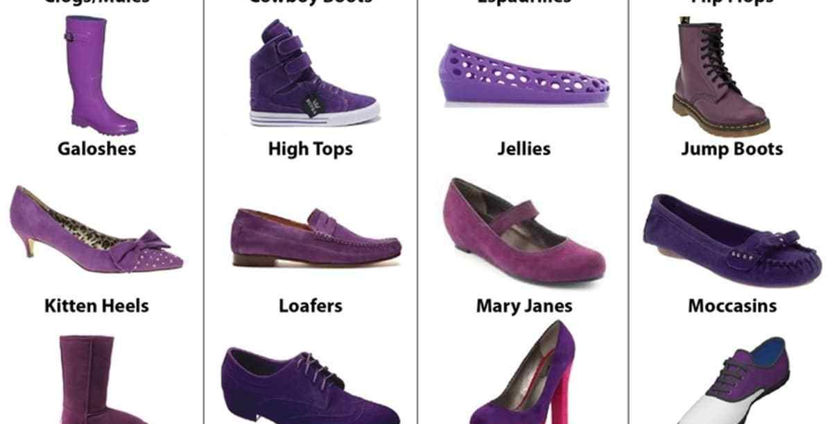
Pumps, Slingbacks, Mules and More…
Big Shoe Sale
Shoes, Shoes, Shoes
Blowout on Styles You Love

